Slide 1

Perfumia
Prepared by: Lara Srour

Slide 2
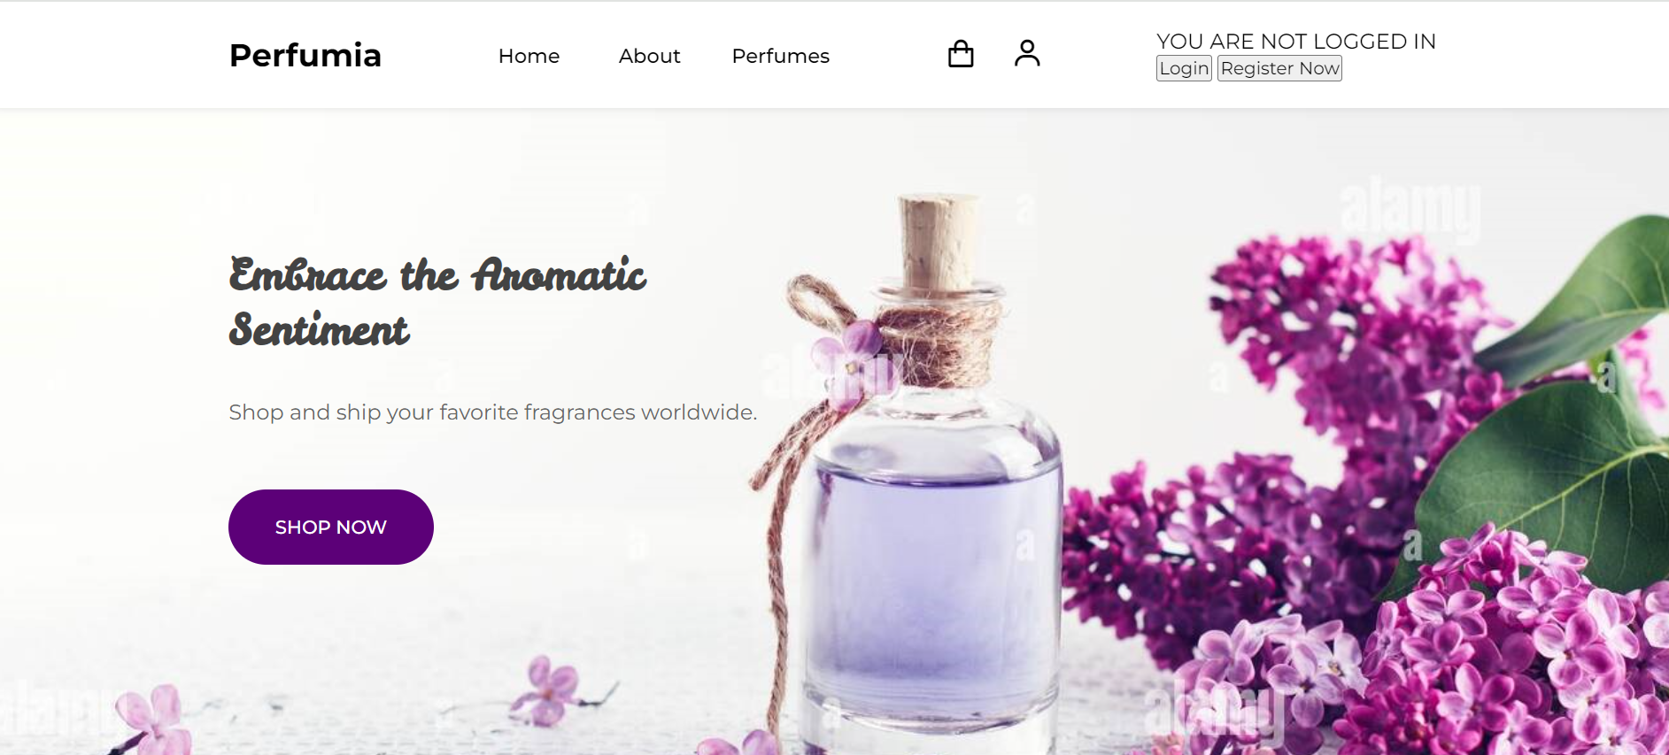

Home Page
To login page
To registration page

Slide 3
Home page
In the header,
if a user is not logged in, the header displays "Not Logged In" along with two buttons: "Login" and "Register Now."
If a user/admin login successfully, the user/admin name and email are displayed, along with a "Logout" button.
Accessing the Cart Page: when users click on the cart icon, they are redirected to the cart page. This page allows users to review their selected products, make modifications (such as updating quantities or removing items), and proceed to the checkout process.

Slide 4
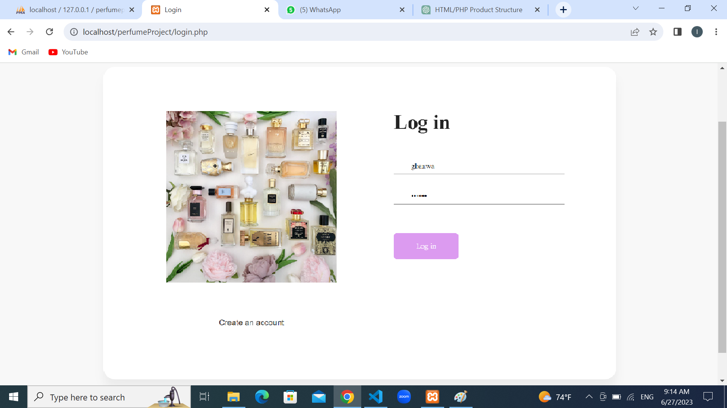
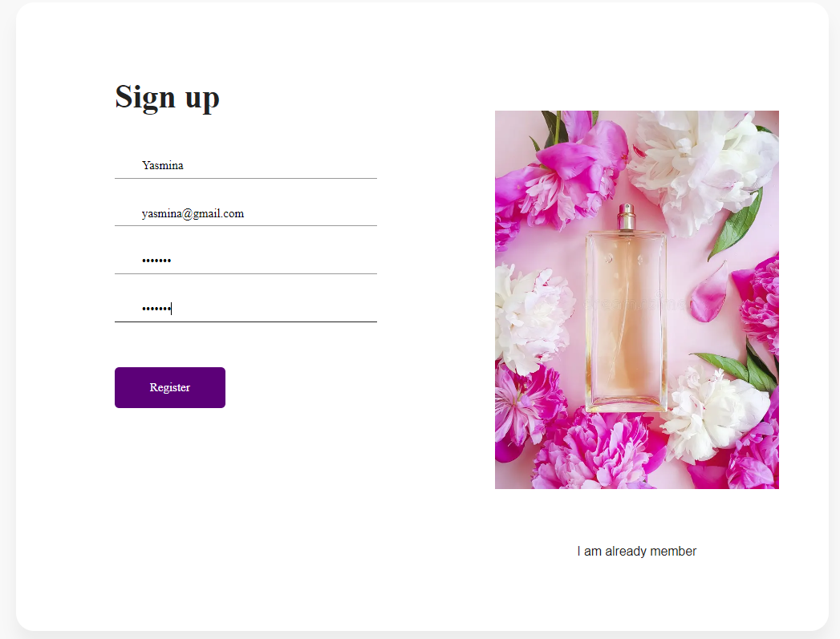
Login/Registration pages
email
password
Add user to data base
To register page
To login page

Slide 5
Login/Registration pages
Registration Page: Allows new users to create an account and store their information in the database.
Login Page: Provides a way for registered users to authenticate themselves and access their personalized account.
Upon successful authentication, a session is created for the user, allowing them to access their account and perform various actions, such as making orders.

Slide 6
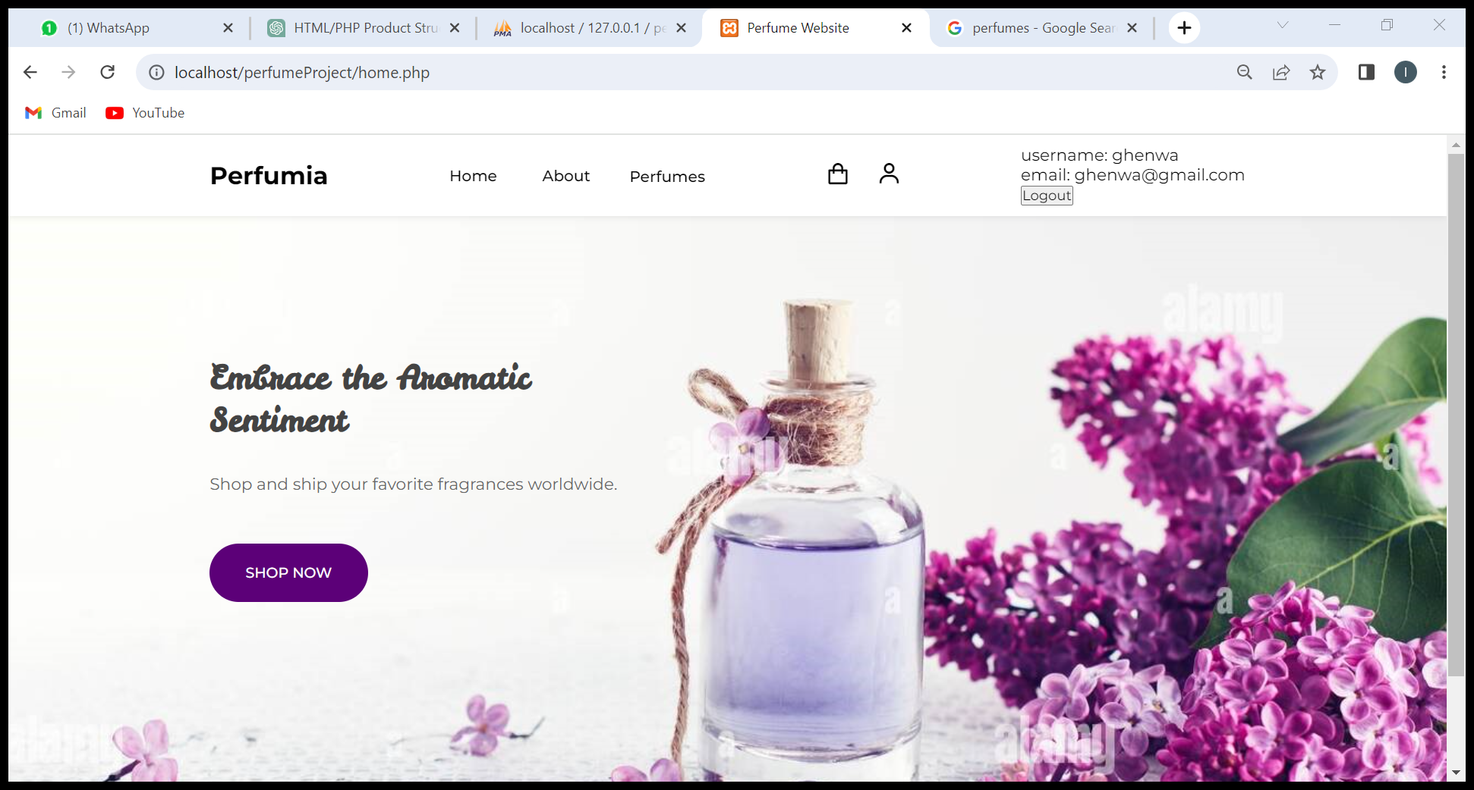
Home Page(after a user login)
User info
Logout: destroy sesison

Slide 7
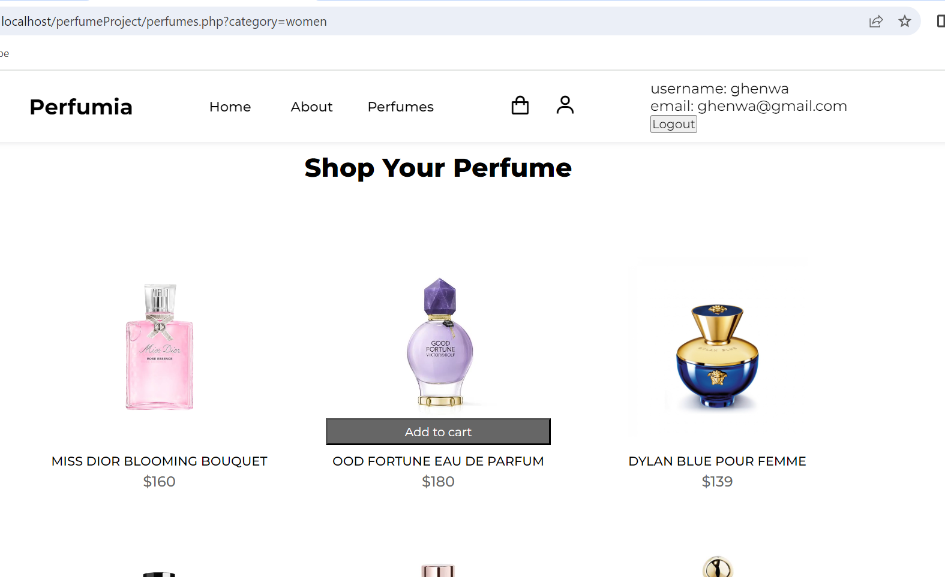
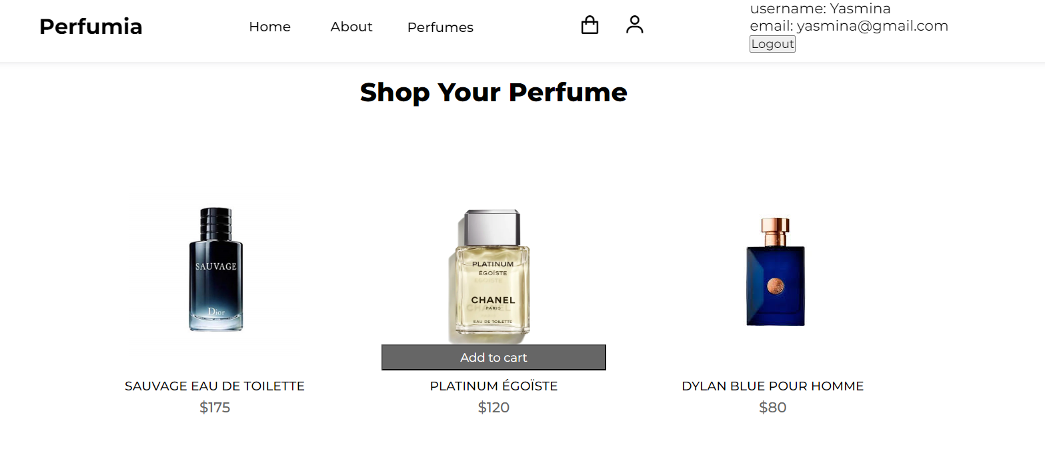
Perfumes page
Women Page
Men Page
To product page
add product*1time to user cart

Slide 8
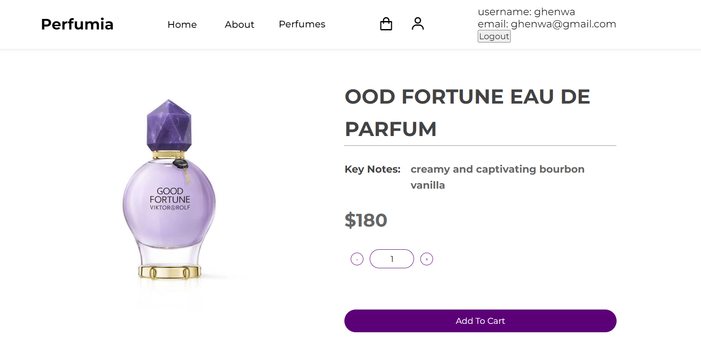
Product Page
Adjust quantity
add product*quantity time to cart

Slide 9
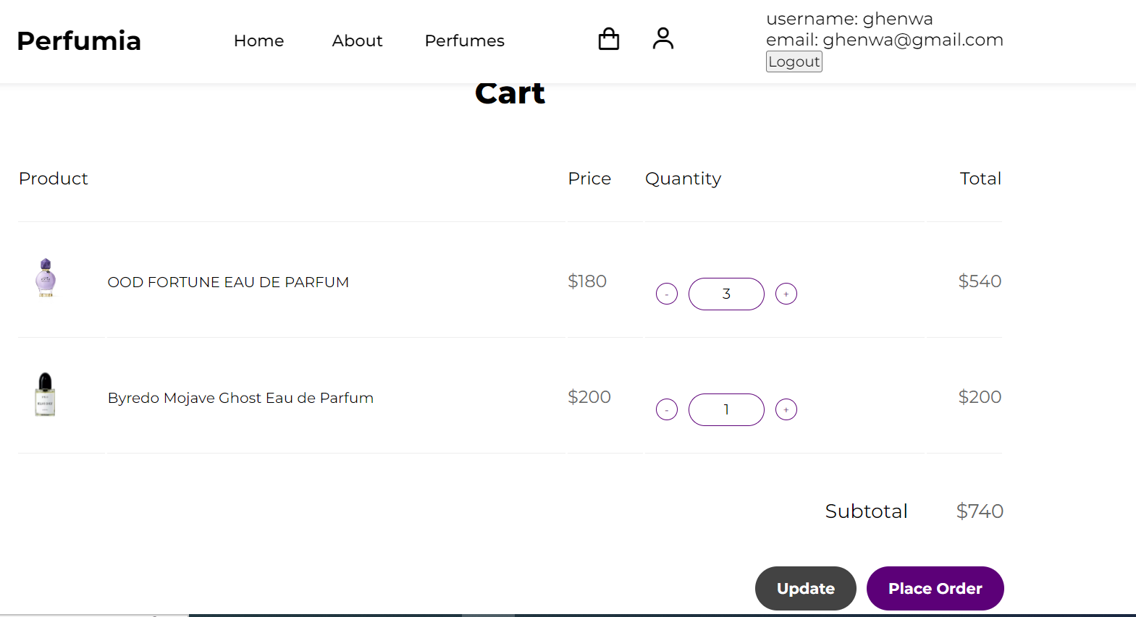
Cart Page
If quantity 0 after update it will be removed from cart table
Update the cart page & go to checkout page
Update the data in the cart table

Slide 10
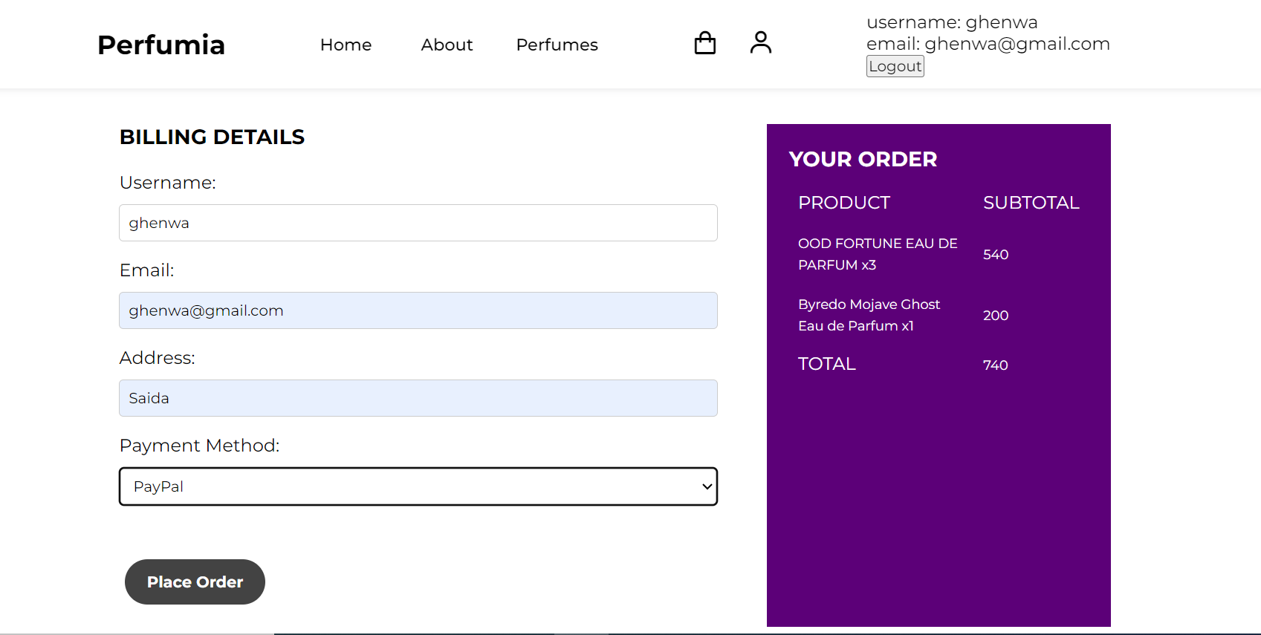
Checkout Page
display the user’s products in cart page (checked=‘0’)
Enter the order info to the orders table in database

Slide 11
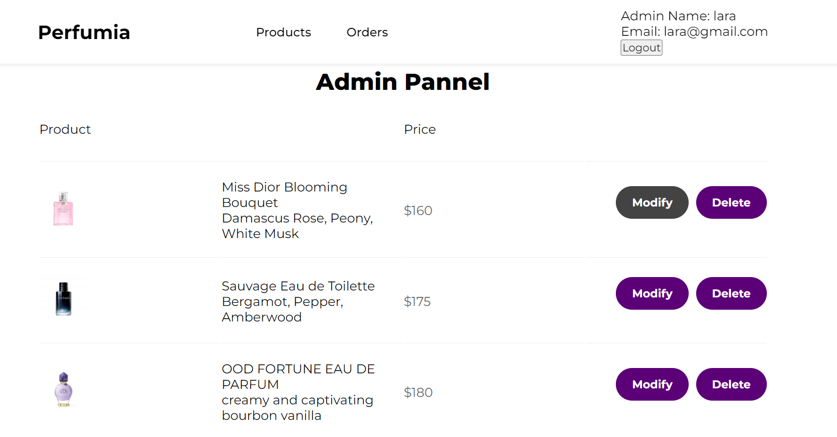
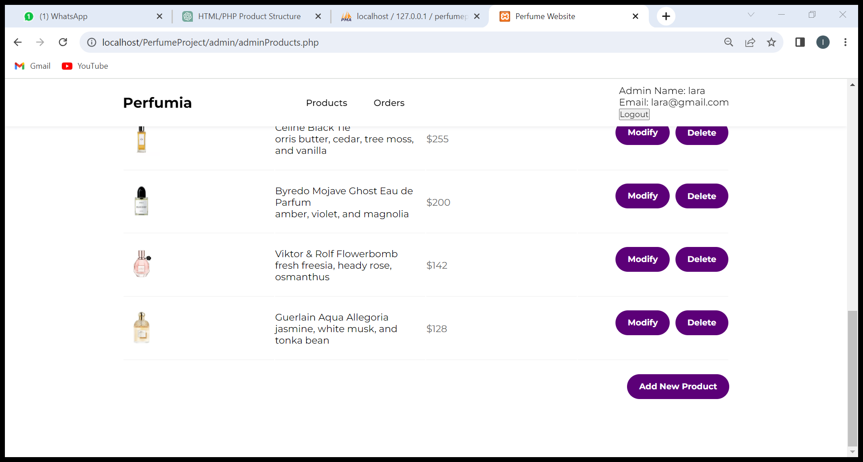
Admin Pannel
Admin info
Delete product from products table in database and remove it from this page
To product_info page

Slide 12
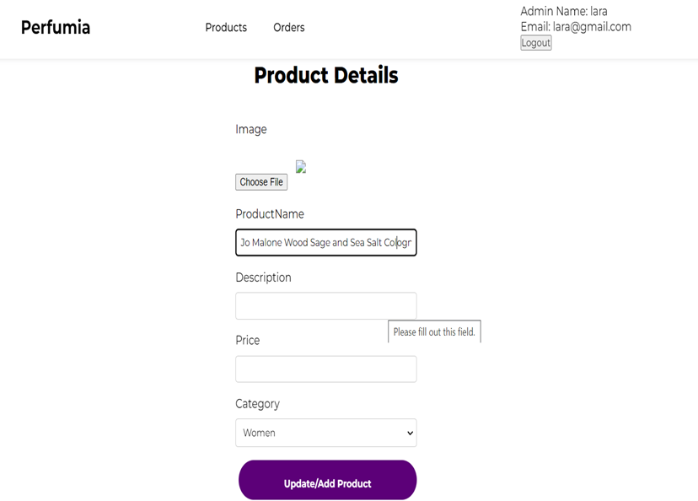
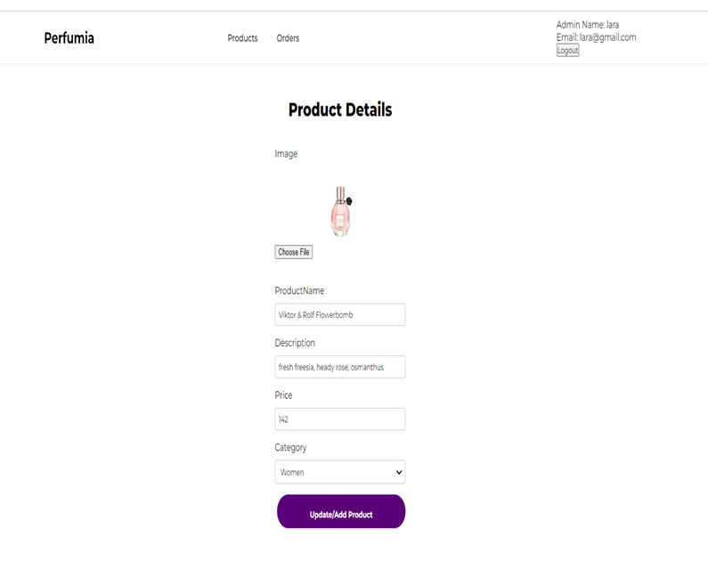
Product_info Page
From add new product button, empty form
From modify button, filled form from products table in database
If a product already in database it will update its info otherwise it will insert it as new product

Slide 13
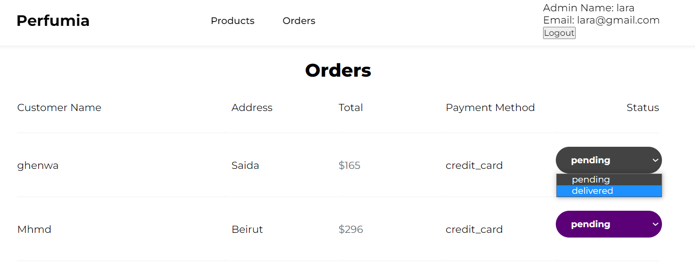
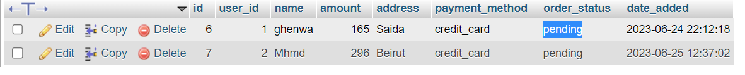
Orders Page
The admin can change the order status when it is delivered

Slide 14
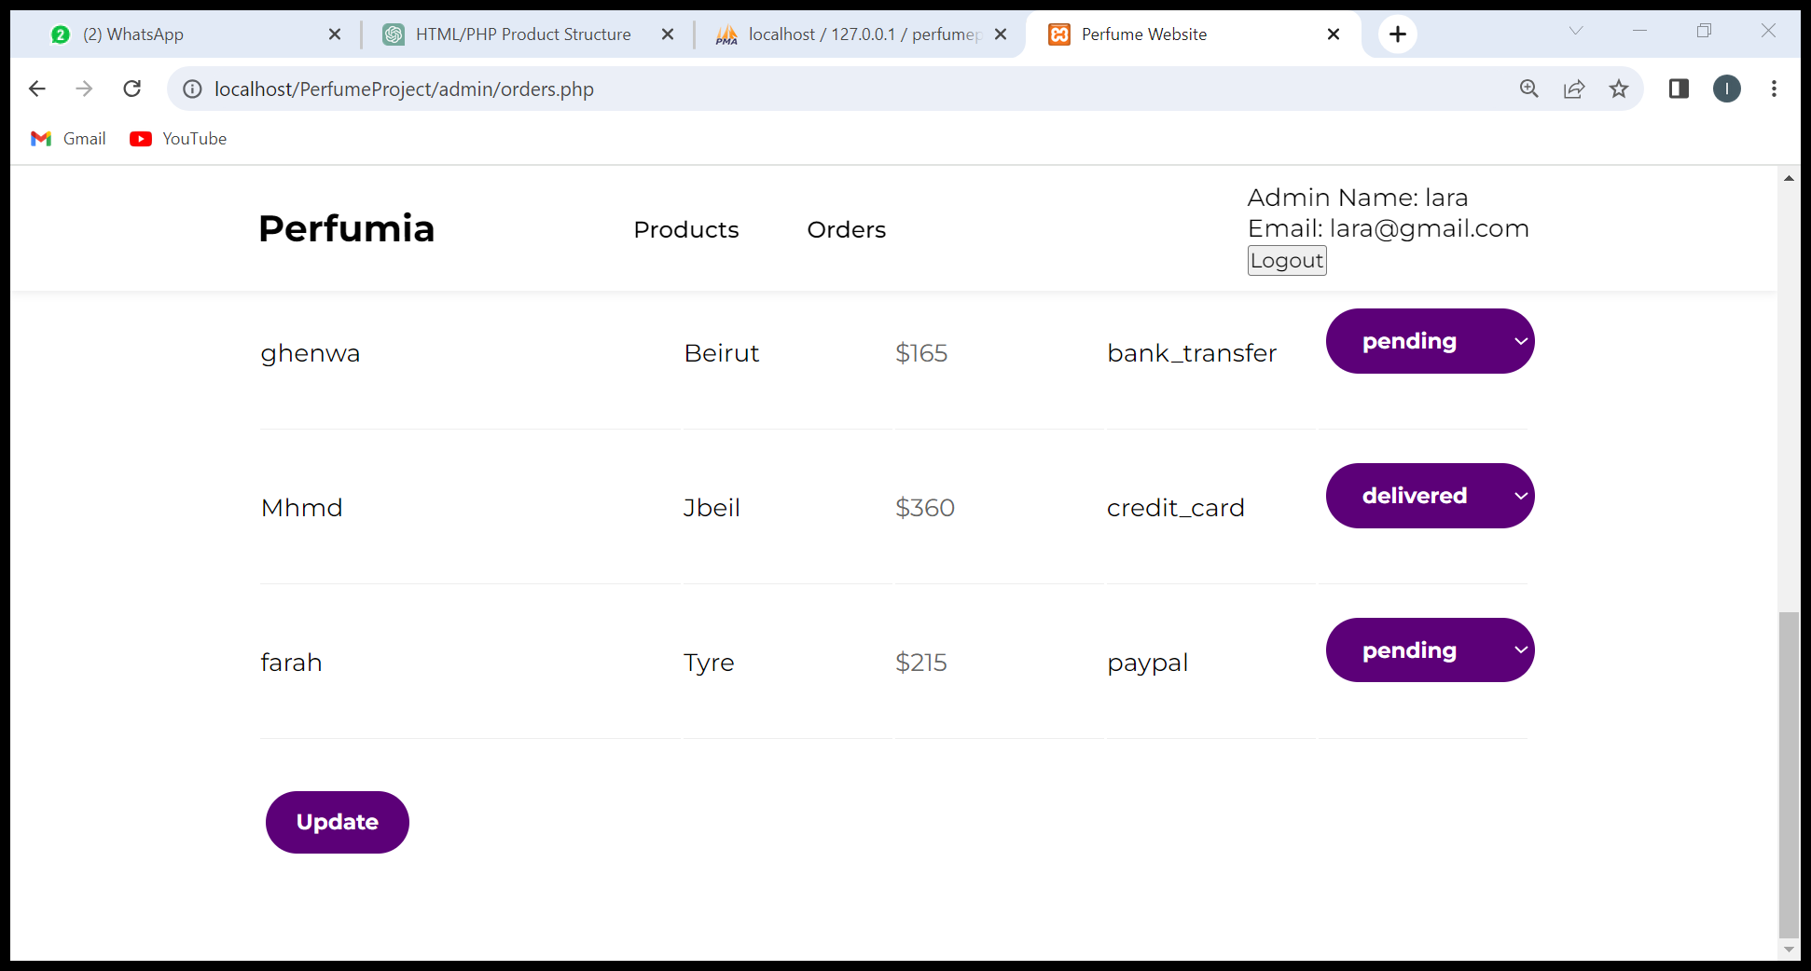
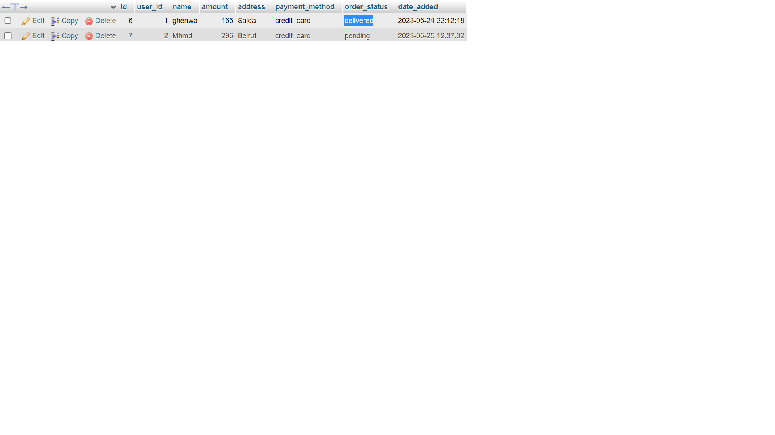
Orders page
Update the order_status in orders table

Slide 15
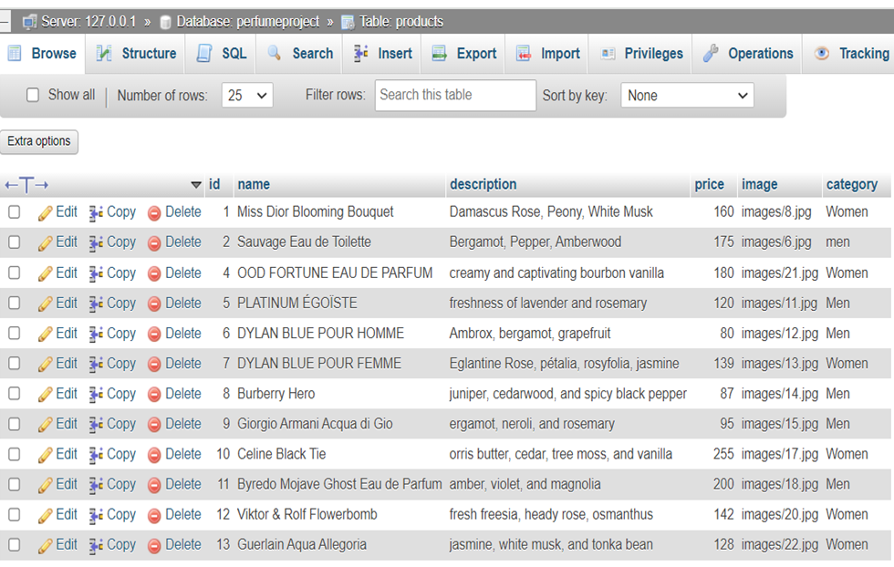
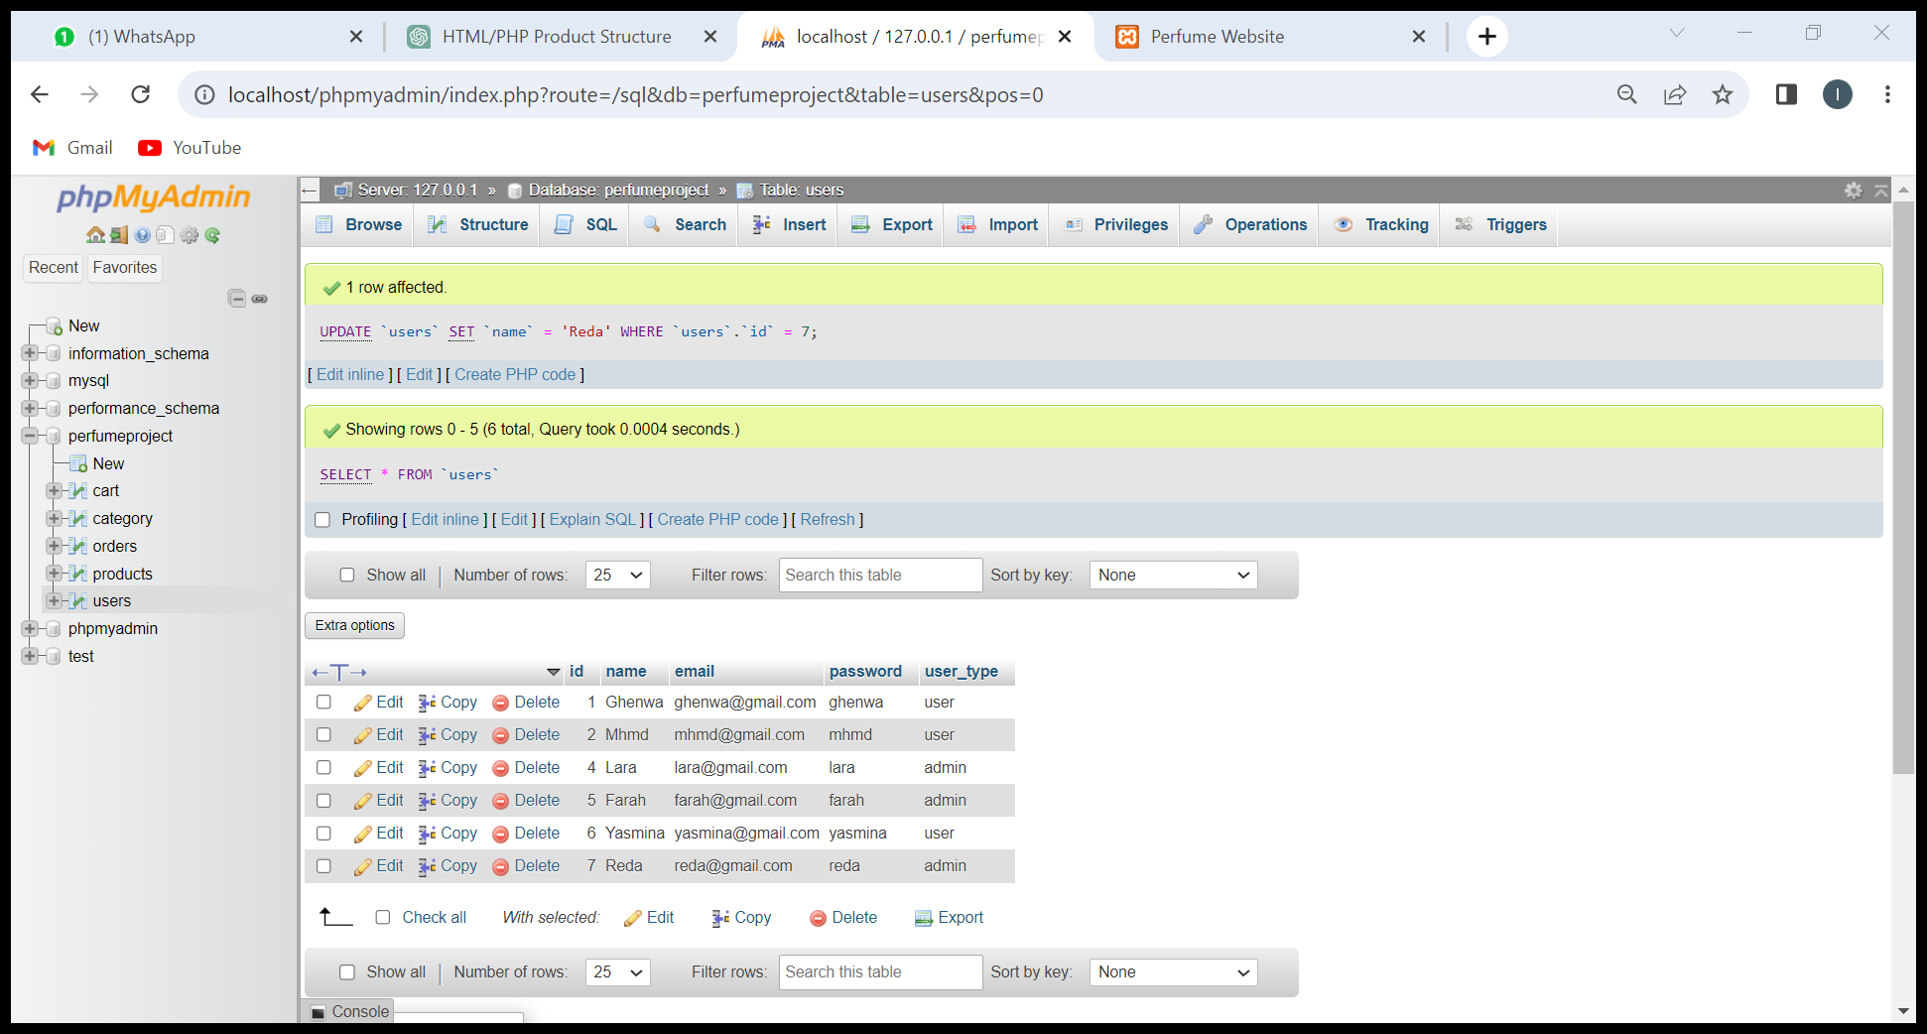
Database
Products table
Users table

Slide 16
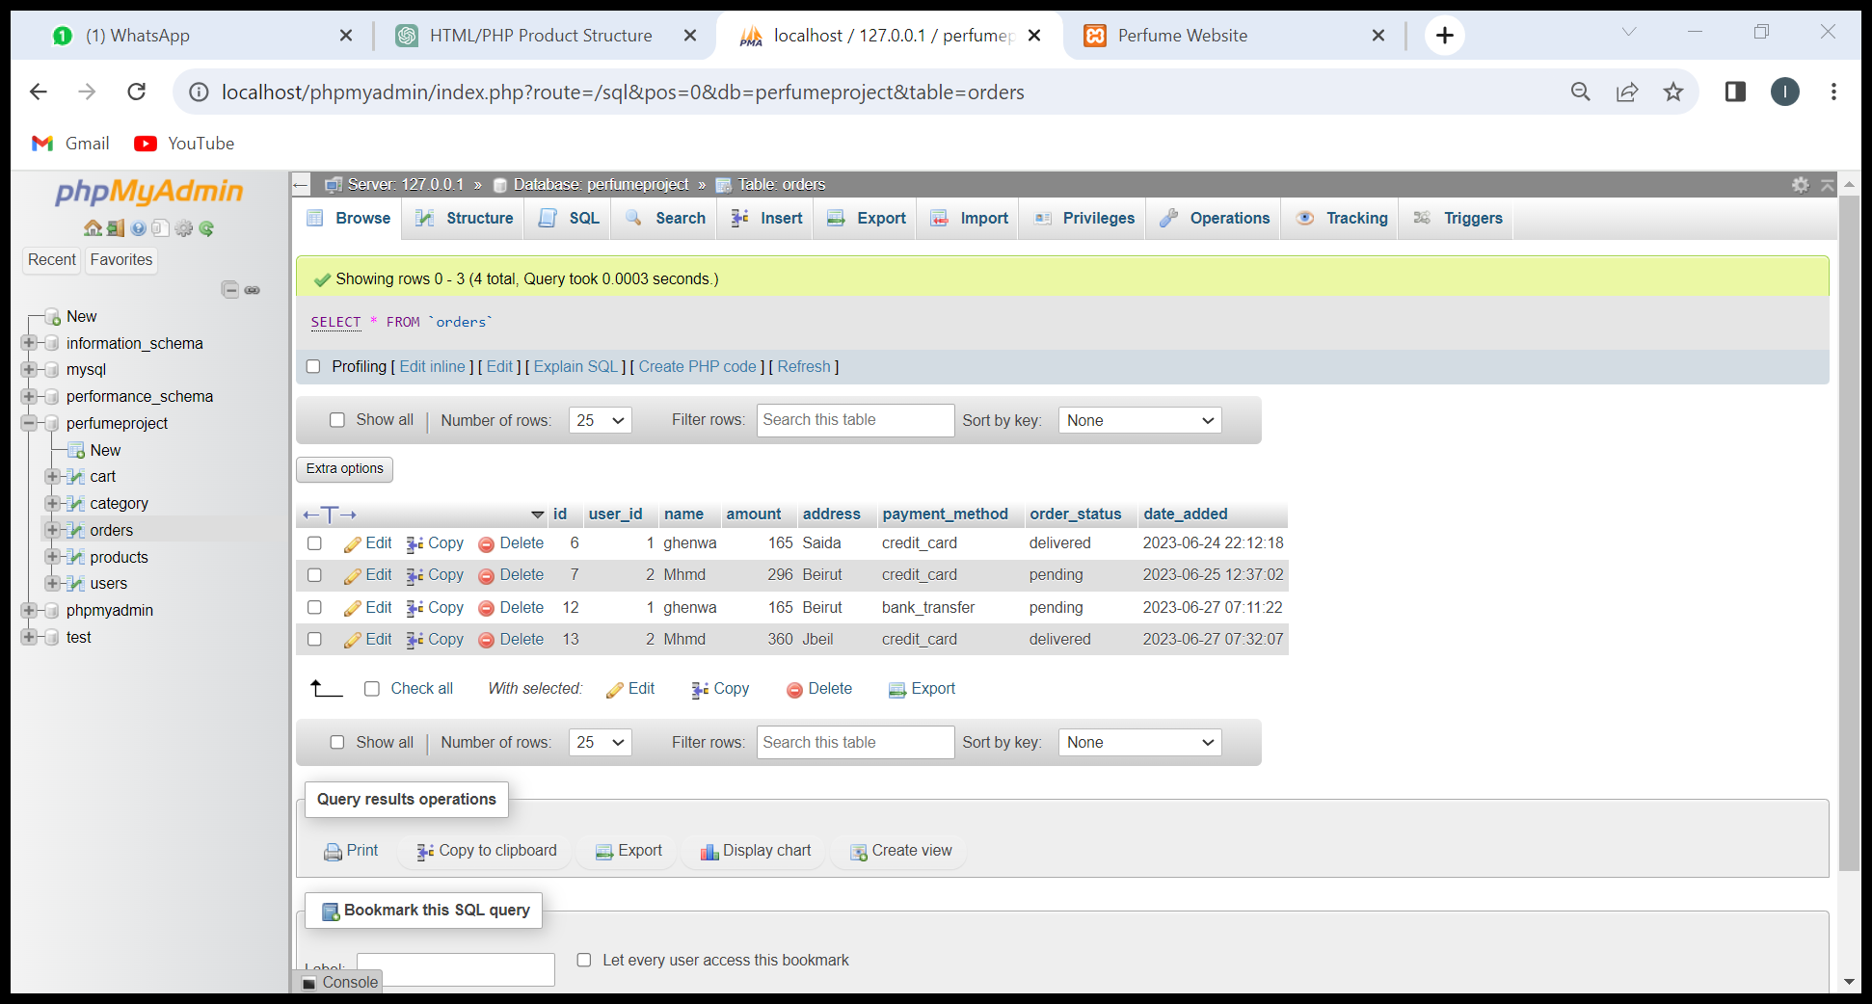
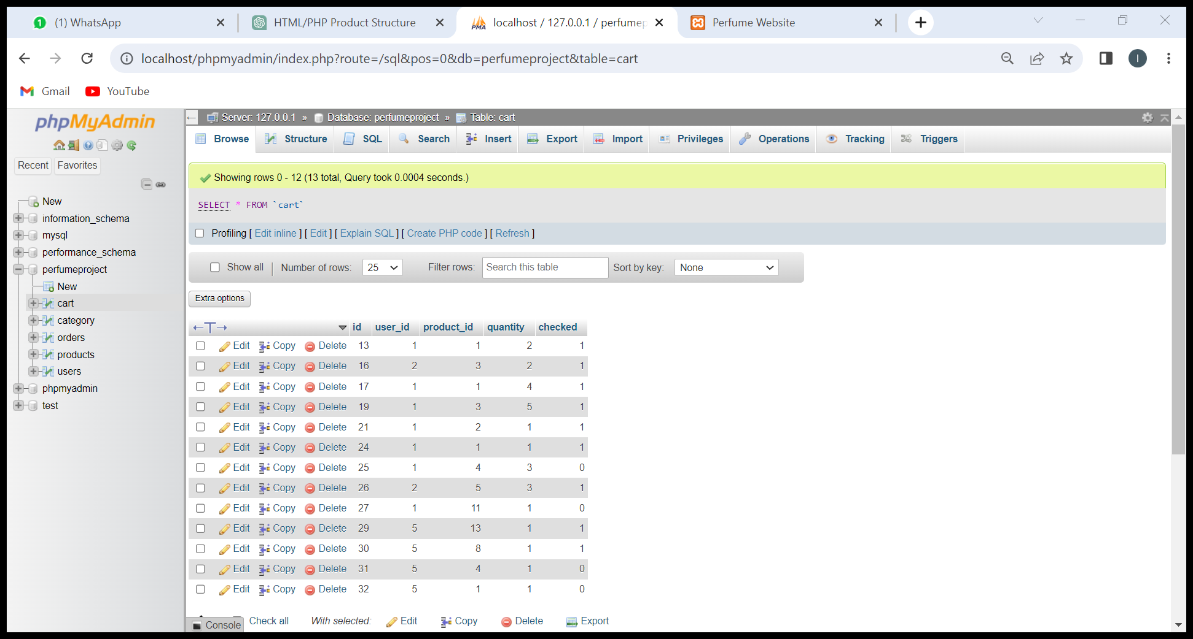
Database
Orders table
Cart table

Slide 17

Thank You!

